Slide 1

“ Web Scraping and Analysis of Manali Tour Packages ”

Slide 2
About me
Background: B.Tech (Computer Science)
Why Data Analytics: Because I enjoy converting raw data into meaningful insights. SQL and analytics help me understand real-world business problems and make data-driven decisions.
Work Experience: Fresher

Slide 3
Problem Statement
Travelers often want to find and compare the best Manali tour packages in one place, but the information on many travel websites is scattered across multiple pages and formats. It becomes difficult to:
Understand what destinations and experiences are available
Compare costs, inclusions, and features of different packages
Interpret why certain locations or types of tours are highlighted over others
To help users make better decisions, it’s essential to analyze and structure the information on this manali tour packages page in a clear, systematic way.

Slide 4
Objective
The main objectives of analyzing the given link are:
Identify and understand the structure of tour package information offered for Manali.
Extract useful insights such as destination options, types of tours, price ranges, and inclusions.
Present this information in an organized format that helps users quickly evaluate what the India tour packages include and why they may choose a particular one.

Slide 5
From Where the Data Is Obtained
All the information and the data for analysis comes directly from the Travel Triangle tour packages page.
Including:
Lists of Manali destinations and top places to visit
Descriptions of regions and their attractions
Examples of packages with durations, prices, and features
Customizable filters like budget and activities etc.

Slide 6
Web Scraping – Details
Website Scraped
  Manali Tour Packages page from TravelTriangle.
Tools & Technologies
  Python
  Requests
  BeautifulSoup
  Pandas
Process Followed
  Identified the target URL
  Sent HTTP requests using headers
  Parsed HTML using BeautifulSoup
  Extracted relevant fields:
    Destination name
    Package duration
    Price
    Package title

Slide 7
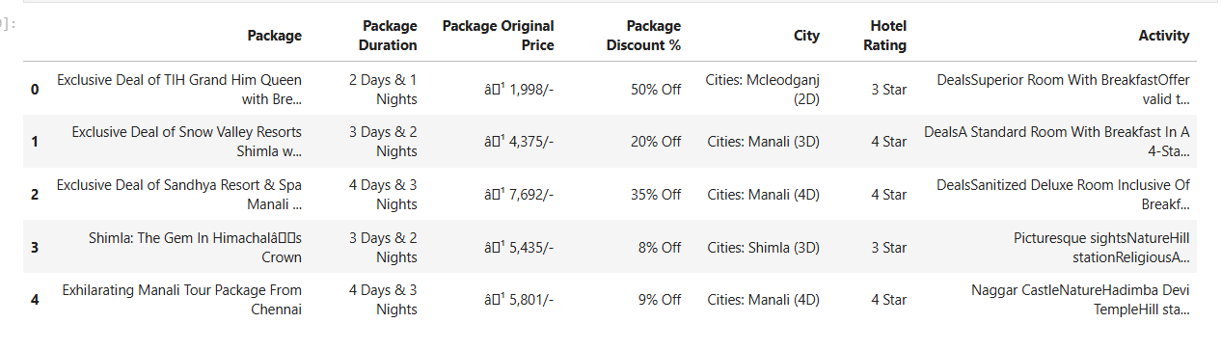
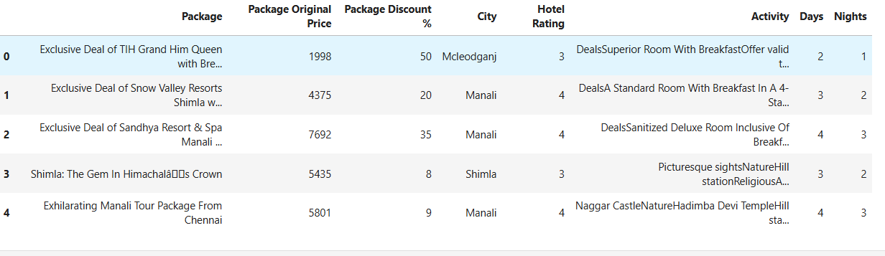
Dataset
Raw data
Clean data

Slide 8
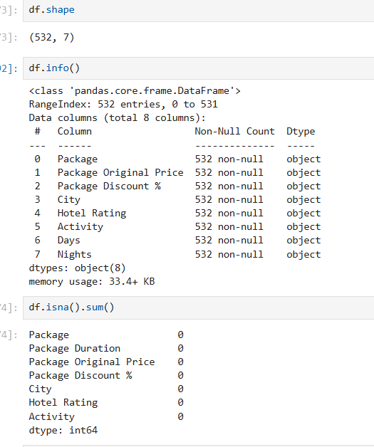
Exploratory Data Analysis:
Overview of the data

Slide 9
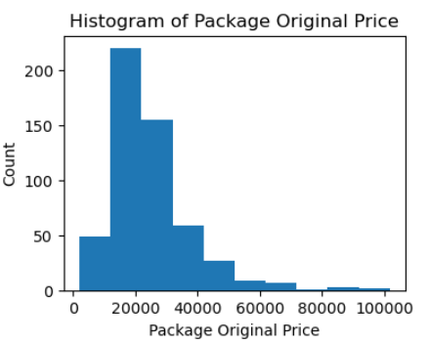
Problem Statement !!!
Analyze the distribution of Package Original Price?
Insight :- Numerical data
Prices are right-skewed, meaning most tour packages are affordable, with only a few very expensive ones
A small number of high-priced packages create a long tail, indicating premium or luxury tours.

Slide 10
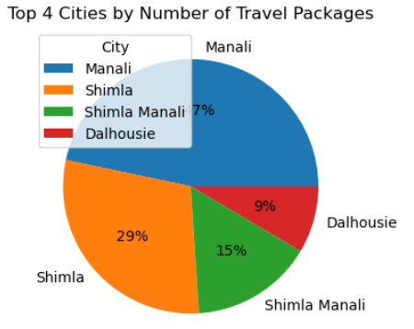
2. Analyze the top 4 popular travel destinations.2. How are prices distributed across packages?
Insight :- Categorical data
The pie chart shows that travel packages are heavily concentrated in a few top cities.
These cities dominate the market, while other cities contribute a relatively smaller share of packages.

Slide 11
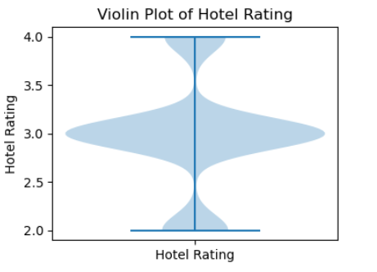
3. Analyze the Hotel Rating
How are ratings distributed?
Insight :- Numerical data
Ratings are mostly clustered around higher values (3–4 stars), indicating good overall service quality.
Very few low ratings (1–2 stars) are observed, showing limited negative feedback.
Overall customer sentiment is positive, suggesting high satisfaction with tour packages.

Slide 12
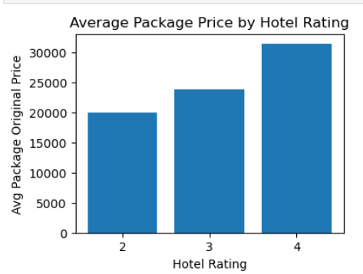
4. How does Hotel Rating affect the Package Original Price?e and Rating
Insight :- Numerical - Numerical
There is a positive relationship between price and rating.
Premium packages tend to deliver better quality, leading to higher ratings.
Customers perceive higher-priced packages as better value.

Slide 13
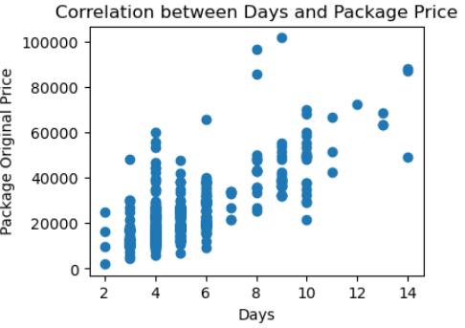
5. What is the relationship between Number of Days and Package Original Price ?Pri vs Rating by Price Segment
Insight :- Numerical - Numerical
There is a positive relationship between the number of days and package price. However, price variation within the same duration suggests that other factors also influence package pricing.
Travel companies can price longer packages higher but should also consider service quality and destination.

Slide 14
Business Insights
Budget packages dominate, showing high demand for affordable travel.
Higher-priced packages receive better ratings, indicating superior quality.
Longer-duration tours maintain stable and higher satisfaction.
Clear segmentation exists between budget and premium travelers.

Slide 15
Conclusion
This project successfully analyzed Manali tour package data using web scraping and exploratory data analysis.
The results show that while budget packages attract most travelers, premium packages deliver higher satisfaction.
Such insights can help travel platforms optimize pricing, improve package quality, and target the right customer segments effectively.

Slide 16

THANK YOU

